Slide 1

6th Grade Accelerated Math
Unit 5, Lesson 2 Using Models to Represent Ratios Volume 1, pg. 178

Slide 2



Benchmark
MA.6.AR.3.1
Given a real-world context, write and interpret ratios to show the relative sizes of two quantities using appropriate notation: $\frac{a}{b}$, $a$ to $b$, or $a:b$where $b≠0$.
volume 1, pg. 178

Slide 3
Integrated Mathematical Thinking and Reasoning Standards
MA.K12.MTR.2.1 Demonstrate understanding by representing problems in multiple ways.
MA.K12.MTR.7.1 Apply mathematics to real-world contexts.
volume 1, pg. 178

Slide 4

Learning Targets
I can write and interpret ratios.
I can represent ratios using various models.
volume 1, pg. 178

Slide 5

Warm-Up
volume 1, pg. 179

Slide 6
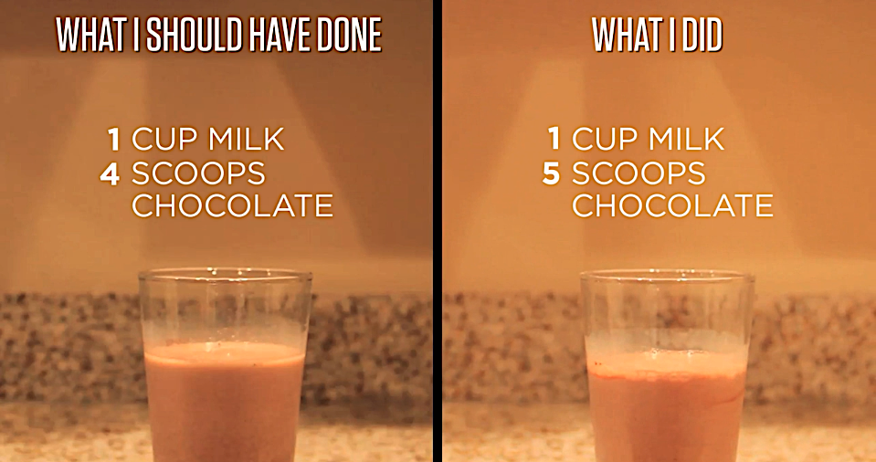
5.2.1 Warm-Up: Nana’s Chocolate Milk
Dan’s Nana prefers her chocolate milk made with just the right “chocolateyness,” but he made a mistake when mixing it for her. The image below shows what Dan should have mixed and what he actually mixed.
volume 1, pg. 179

Slide 7
Describe what Dan did wrong.
How could Dan fix it so that the glass contains Nana’s preferred balance of milk and chocolate?
volume 1, pg. 179

Slide 8

Exploration
volume 1, pg. 179

Slide 9

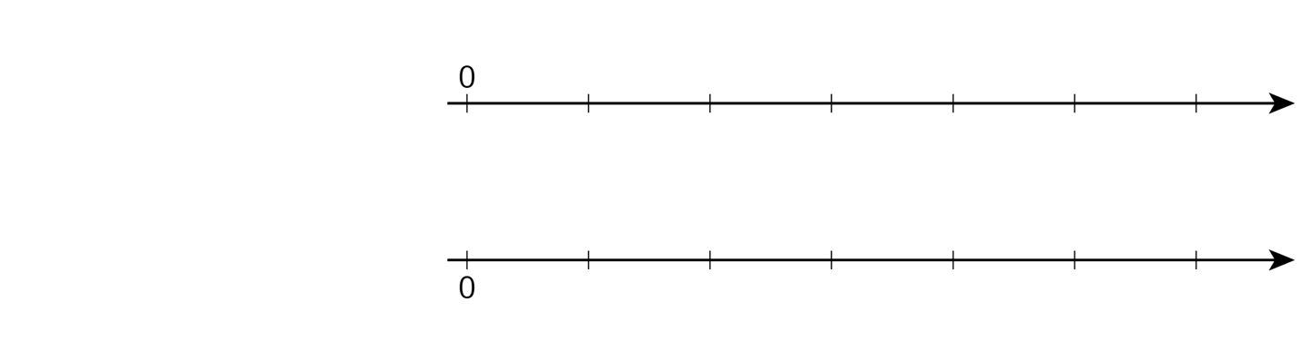




5.2.2 Exploration: Using Double Line Diagrams to Represent Ratios
Nana’s chocolate milk recipe calls for 4 scoops of chocolate for every 1 cup of milk. One way to represent the recipe is with a double number line diagram.
Milk
(cups)
$$0$$
$$1$$
Chocolate (scoops)
$$0$$
$$4$$
volume 1, pg. 179

Slide 10
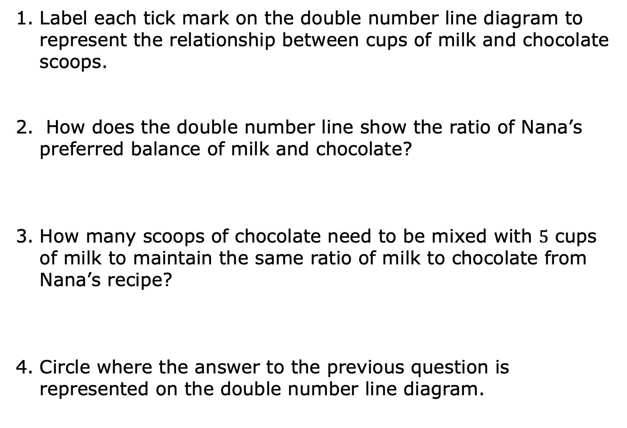
Label each tick mark on the double number line diagram to represent the relationship between cups of milk and chocolate scoops.
How does the double number line show the ratio of Nana’s preferred balance of milk and chocolate?
How many scoops of chocolate need to be mixed with $5$ cups of milk to maintain the same ratio of milk to chocolate from Nana’s recipe?
Circle where the answer to the previous question is represented on the double number line diagram.
volume 1, pg. 179

Slide 11
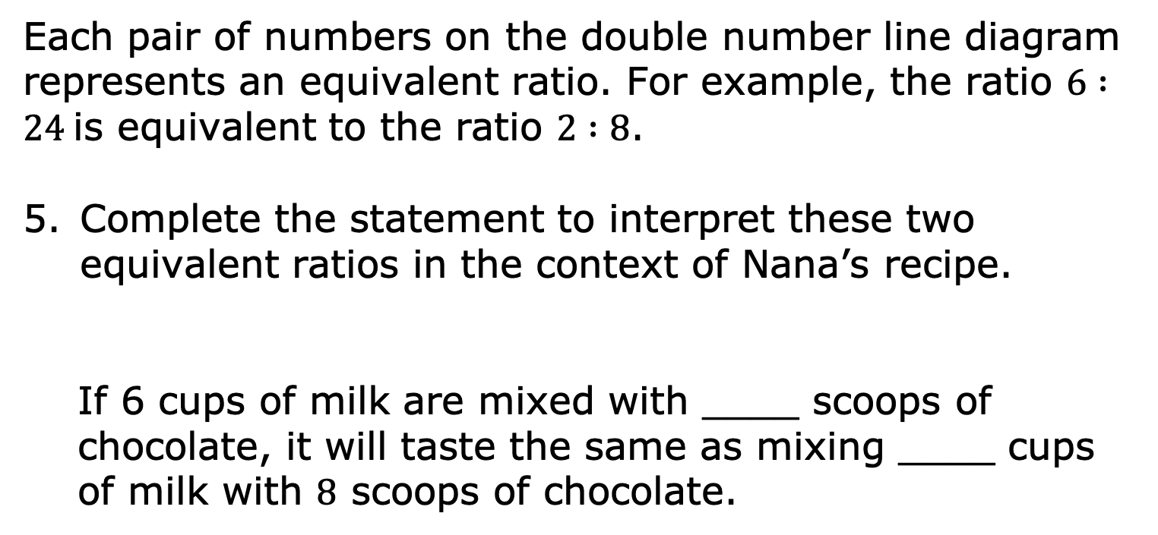
Each pair of numbers on the double number line diagram represents an equivalent ratio. For example, the ratio $6 :24$is equivalent to the ratio $2 :8$.
Complete the statement to interpret these two equivalent ratios in the context of Nana’s recipe.
If 6 cups of milk are mixed with ____ scoops of chocolate, it will taste the same as mixing ____ cups of milk with $8$ scoops of chocolate.
volume 1, pg. 180

Slide 12
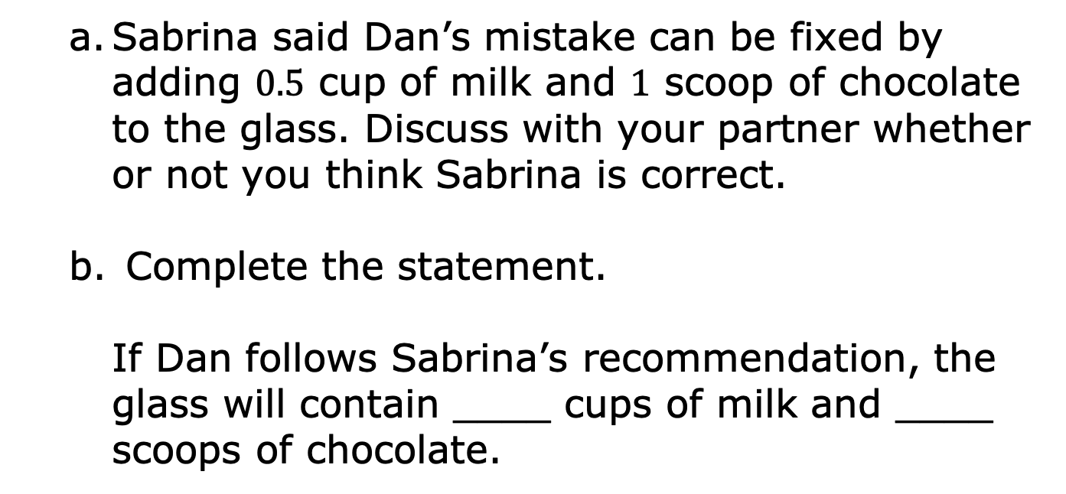
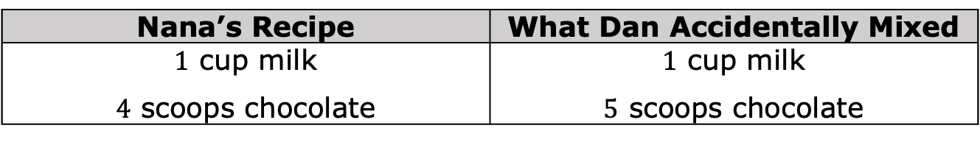
Recall Dan’s error when mixing Nana’s chocolate milk.
Nana’s Recipe | What Dan Accidentally Mixed
$1$ cup milk $4$ scoops chocolate | $1$ cup milk $5$ scoops chocolate
Sabrina said Dan’s mistake can be fixed by adding $0.5$ cup of milk and $1$ scoop of chocolate to the glass. Discuss with your partner whether or not you think Sabrina is correct.
Complete the statement.
If Dan follows Sabrina’s recommendation, the glass will contain ____ cups of milk and ____ scoops of chocolate.
volume 1, pg. 180

Slide 13
Use the double number line diagram to determine whether Sabrina’s recommendation will result in chocolate milk with Nana’s preferred taste.
If Sabrina’s recommendation will work, mark the locations of this mixture on the double number line diagram with two Xs, one on each number line.
volume 1, pg. 180

Slide 14

Try It
volume 1, pg. 180

Slide 15
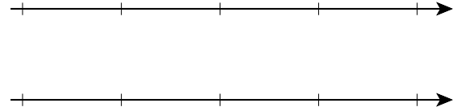


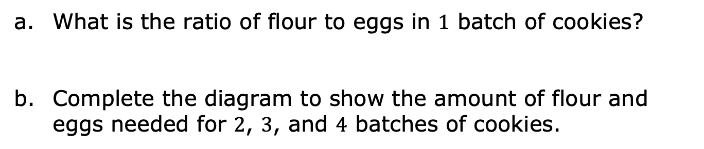


5.2.3 Try It: Using Double Line Diagrams to Represent and Interpret Ratios
A recipe for $1$ batch of cookies calls for $5$ cups of flour and $3$ eggs. A double line diagram is shown to represent the recipe.
$$0$$
$$5$$
Cups of Flour
Number of Eggs
$$0$$
$$3$$
What is the ratio of flour to eggs in $1$ batch of cookies?
Complete the diagram to show the amount of flour and eggs needed for $2$, $3$, and $4$ batches of cookies.
volume 1, pg. 180

Slide 16
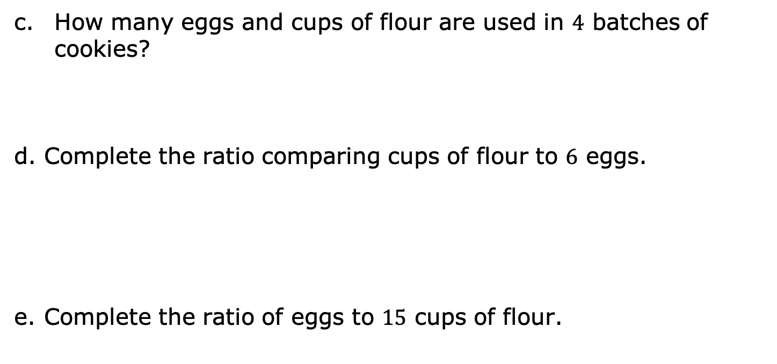


How many eggs and cups of flour are used in $4$ batches of cookies?
Complete the ratio comparing cups of flour to $6$ eggs.
Complete the ratio of eggs to $15$ cups of flour.
$$:6$$
$$\frac{ }{15}$$
volume 1, pg. 180

Slide 17

Guided Instruction
volume 1, pg. 181

Slide 18
5.2.4 Guided Instruction: Using Tape Diagrams to Represent Ratios
A tape diagram is another way to represent ratios. All the parts of the diagram that are the same size have the same value, similar to increments on a number line.
The tape diagram shown represents the ratio of cats to dogs at a local animal shelter.
Number of Cats
Number of Dogs
volume 1, pg. 181

Slide 19

Complete the statements using the tape diagram.
The ratio of dogs to cats is .
For every ____ cats at the shelter, there are ____ dogs.
volume 1, pg. 181

Slide 20
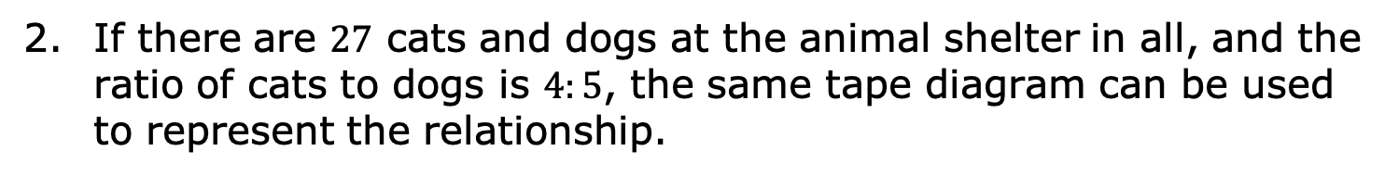
If there are $27$ cats and dogs at the animal shelter in all, and the ratio of cats to dogs is $4:5$, the same tape diagram can be used to represent the relationship.
Number of Cats
Number of Dogs
What is the value of each small rectangle in the diagram given this new information?
Label each small rectangle with this value.
volume 1, pg. 181

Slide 21
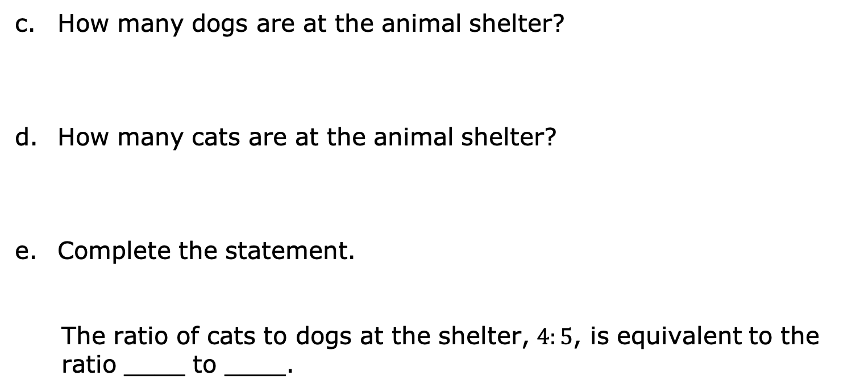
How many dogs are at the animal shelter?
How many cats are at the animal shelter?
Complete the statement.
The ratio of cats to dogs at the shelter, $4:5$, is equivalent to the ratio ____ to ____.
volume 1, pg. 181

Slide 22

Your Turn
volume 1, pg. 182

Slide 23
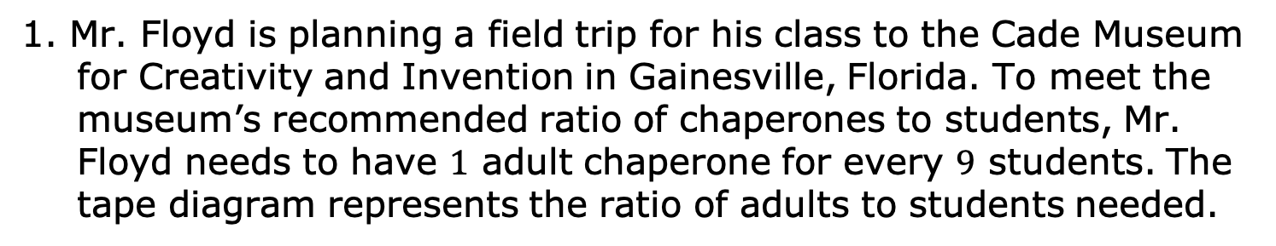
5.2.5 Your Turn!
1. Mr. Floyd is planning a field trip for his class to the Cade Museum for Creativity and Invention in Gainesville, Florida. To meet the museum’s recommended ratio of chaperones to students, Mr. Floyd needs to have $1$ adult chaperone for every $9$ students. The tape diagram represents the ratio of adults to students needed.
Number of Adults
Number of Students
What is the ratio of students to chaperones required by the museum?
volume 1, pg. 182

Slide 24
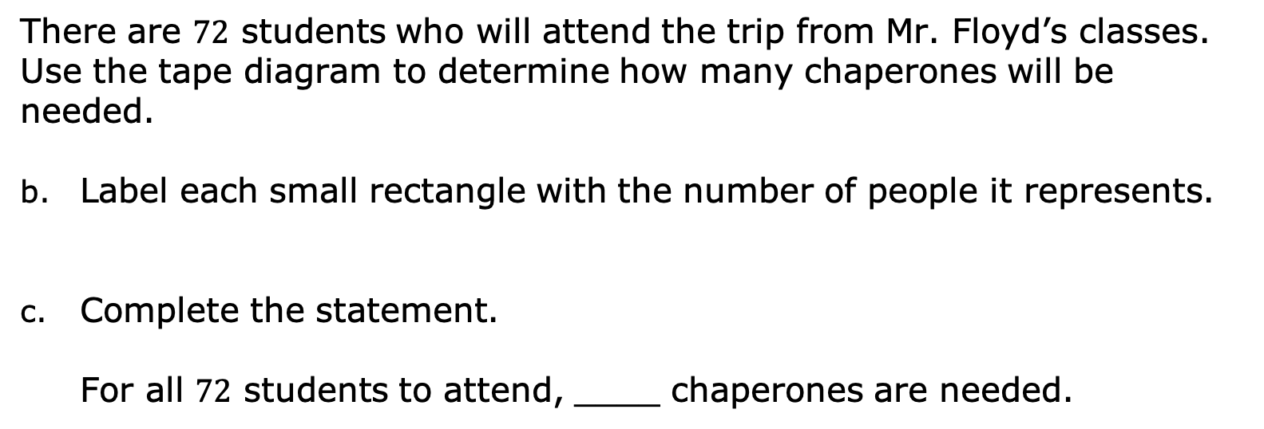
There are $72$ students who will attend the trip from Mr. Floyd’s classes. Use the tape diagram to determine how many chaperones will be needed.
Label each small rectangle with the number of people it represents.
Complete the statement.
For all $72$ students to attend, ____ chaperones are needed.
volume 1, pg. 182

Slide 25




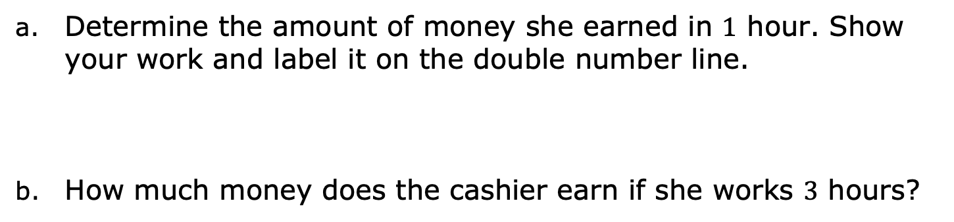

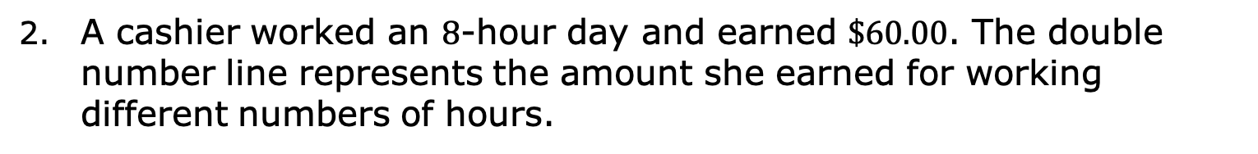

A cashier worked an $8$-hour day and earned $\$60.00$. The double number line represents the amount she earned for working different numbers of hours.
Wages Earned
(dollars)
$$0$$
$$15$$
$$30$$
$$45$$
$$60$$
Time Worked (hours)
Determine the amount of money she earned in $1$ hour. Show your work and label it on the double number line.
How much money does the cashier earn if she works $3$ hours?
volume 1, pg. 182

Slide 26

Wrap-Up
volume 1, pg. 183

Slide 27
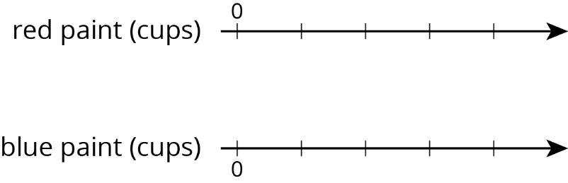
5.2.6 Wrap-Up: Ticket Out the Door
The representation shows the amount of red and blue paint that makes $2$ batches of a particular shade of purple paint called lilac.
Cups of Red Paint
Cups of Blue Paint
On the double number line, label the tick marks to represent amounts of red and blue paint used to make batches of this shade of purple paint.
Cups of Red Paint
Cups of Blue Paint
volume 1, pg. 183

Slide 28
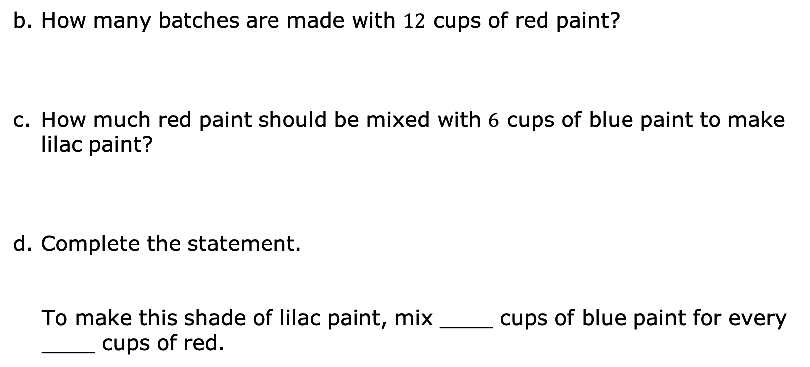
How many batches are made with $12$ cups of red paint?
How much red paint should be mixed with $6$ cups of blue paint to make lilac paint?
Complete the statement.
To make this shade of lilac paint, mix ____ cups of blue paint for every ____ cups of red.
volume 1, pg. 183

